Slide 1




Salesperson Training in Retail Stores
Presented by :
Dakshata Jain
Ritumbhra Sagar
Jiacheng Hu
Kushall Dayal
Xingmin Bao

Slide 2
Agenda
Background
Summary Statistics
Our Approach to Data Analysis
Model Diagnostics
Interpretation of Results
Managerial Insights
Conclusion

Slide 3
Background
Starting 2012, the company offered 3 voluntary training modules to its employees (salesperson & store manager) aimed to improve employees’ sales & return performance
In 2013, the company further improved the training program and introduced 5 new additional modules related to product knowledge and service and selling skills
As Business analysts working on this project, we will use the data (2011-13) for following:
To quantify the impact of the training programs
To assess the change in impact owing to the service years and other parameter for the salespeople
To understand the effect of offering additional training modules

Slide 4
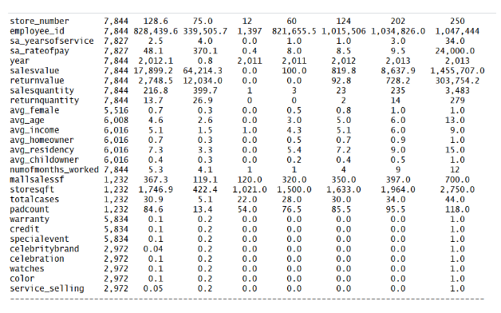
Summary Statistics
Dependent variables
Customer Demographics
(Missing Values – replaced by mean values)
Mall Quality Indicators
(Missing Values – replaced by mean values)
Training Modules offered in 2012
Training Modules offered in 2013
** The variables sa_assignment category, sa_dependent, sa_maritalstatus , sa_gender, st and mallgrade are not available in the summary statistics because of non-numerical data. They have later been changed and used further in the analysis

Slide 5
Our Approach to Data Analysis…
1
What is the impact of training program on salesperson sales and return performance?
SALES VALUE
SALES QUANTITY
RETURN VALUE
RETURN QUANTITY
Data Segregation
(2011, 2012-2013)
Data Segregation
(2011, 2012-2013)
Data Segregation
(2011, 2012-2013)
Data Segregation
(2011, 2012-2013)
OLS Model
(trainingP*grouping)
Poisson / NB Model
(trainingP*grouping)
OLS Model
(trainingP*grouping)
Poisson / NB Model
(trainingP*grouping)
Compare
Compare
Plot Graphs
Negative Binomial Model
Plot Graphs
Negative Binomial Model
Plot Graphs
Plot Graphs

Slide 6
Interpretation of Results
1
What is the impact of training program on salesperson sales and return performance?
SALES VALUE
SALES QUANTITY
Coefficient is insignificant, thus no graph.
There’s no impact of training program on salesperson’s annual sales value.
Coefficient is insignificant, thus no graph.
There’s no impact of training program on salesperson’s annual sales quantity.

Slide 7
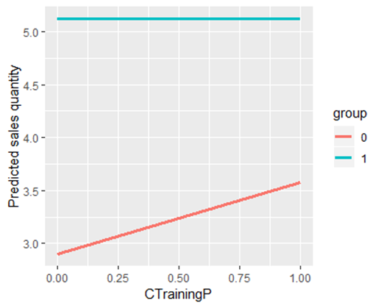
Interpretation of Results
1
What is the impact of training program on salesperson sales and return performance?
RETURN VALUE
RETURN QUANTITY
Coefficient is insignificant, thus no graph.
There’s no impact of training program on salesperson’s annual return value.
The impact of training program on salesperson’s return quantity is -21%

Slide 8
Our Approach to Data Analysis…
2
What is the impact of completing at least one training module on salesperson sales and return performance?
SALES VALUE
SALES QUANTITY
RETURN VALUE
RETURN QUANTITY
Data Segregation
(2012, 2013)
Data Segregation
(2012, 2013)
Data Segregation
(2012, 2013)
Data Segregation
(2012, 2013)
OLS Model
(atleast1module)
Poisson / NB Model
(atleast1module)
OLS Model
(atleast1module)
Poisson / NB Model
(atleast1module)
Compare
Compare
IV / 2SLS Model
(married, child)
Negative Binomial Model
IV / 2SLS Model
(married, child, female)
Negative Binomial Model
Pass
Compare with OLS
Doesn’t Pass
Compare with OLS
Plot Graphs
OLS Model
OLS Model
OLS Model
IV / 2SLS Model
(married, child)
Plot Graphs
IV / 2SLS Model
(married, child)
Pass
Pass
Plot Graphs
Plot Graphs

Slide 9
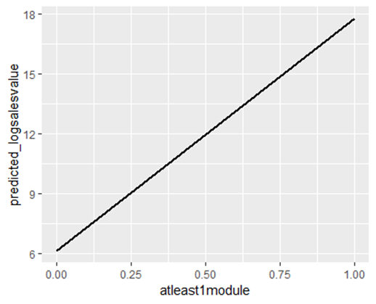
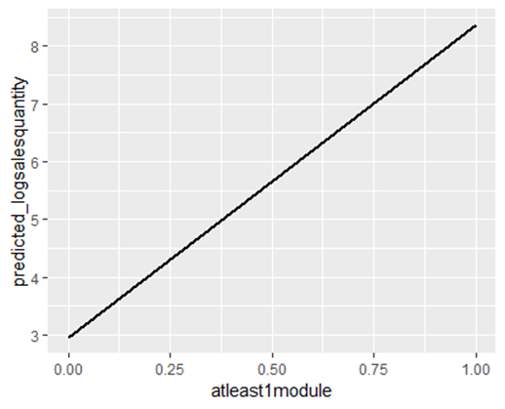
Interpretation of Results
2
What is the impact of completing at least one training module on salesperson sales and return performance?
SALES VALUE
SALES QUANTITY
If the salesperson completes at least 1 training, his annual sales value will increase by 1170%
If the salesperson completes at least 1 training, his sales quantity will increase by 541%

Slide 10
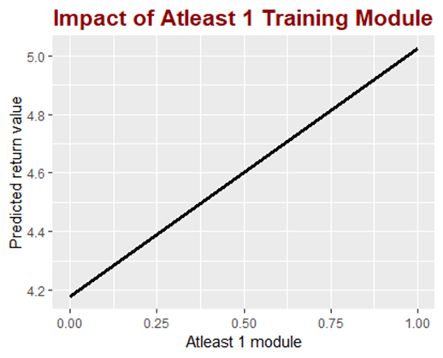
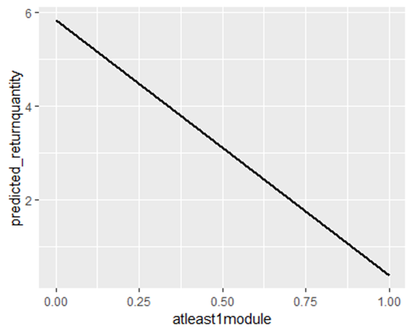
Interpretation of Results
2
What is the impact of completing at least one training module on salesperson sales and return performance?
RETURN VALUE
RETURN QUANTITY
If the salesperson completes at least 1 training, his annual return value will increase by 84.86%
If the salesperson completes at least 1 training, his annual return quantity will decrease by 276%

Slide 11
Our Approach to Data Analysis…
3
What is the impact of completing every additional training module on salesperson sales and return performance?
SALES VALUE
SALES QUANTITY
RETURN VALUE
RETURN QUANTITY
Data Segregation
(2012, 2013)
Data Segregation
(2012, 2013)
Data Segregation
(2012, 2013)
Data Segregation
(2012, 2013)
OLS Model
(additionalP)
Poisson / NB Model
(additionalP)
OLS Model
(additionalP)
Poisson / NB Model
(additionalP)
Compare
Compare
IV / 2SLS Model
(married, child, trainedratio)
Negative Binomial Model
IV / 2SLS Model
(married, trainedratio)
Negative Binomial Model
Pass
Compare with OLS
Doesn’t Pass
Compare with OLS
Plot Graphs
OLS Model
OLS Model
OLS Model
IV / 2SLS Model
(married, child, trainedratio)
Plot Graphs
IV / 2SLS Model
(married, child, trainedratio)
Pass
Doesn’t Pass
Plot Graphs
Plot Graphs using OLS

Slide 12
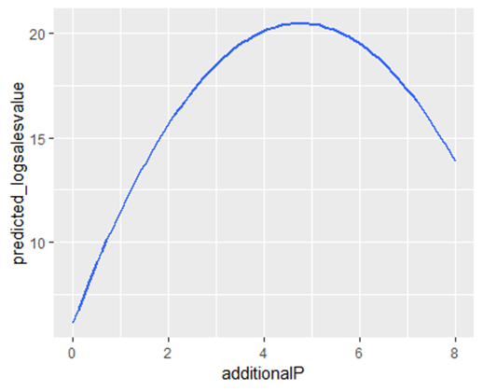
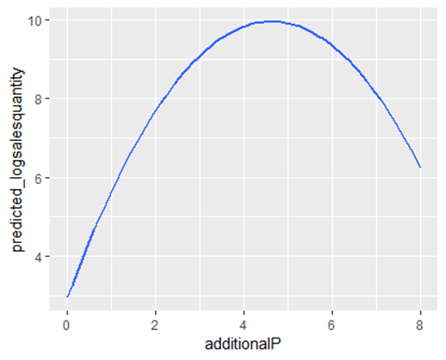
Interpretation of Results
3
What is the impact of completing every additional training module on salesperson sales and return performance?
SALES VALUE
SALES QUANTITY
For every additional training that the salesperson takes, the annual sales value will increase by 475.27%
For every additional training that the salesperson takes, the annual return value will increase by 236%

Slide 13
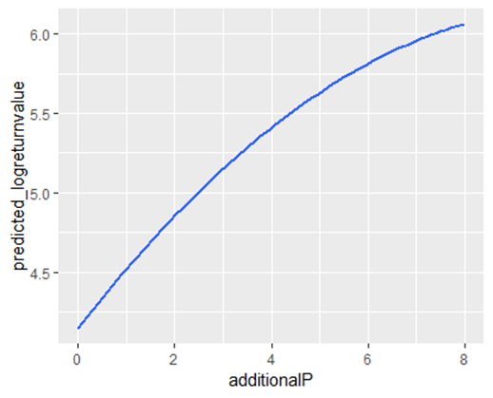
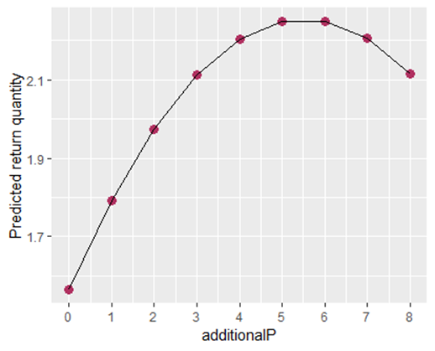
Interpretation of Results
3
What is the impact of completing every additional training module on salesperson sales and return performance?
RETURN VALUE
RETURN QUANTITY
Not significant, there’s no effect for taking additional training modules in their return value.
For every additional training that the salesperson takes, the annual return quantity is associated with increase by 21%

Slide 14
Our Approach to Data Analysis…
4
Who benefits from the training more : Full-time employees or part-time employees?
SALES VALUE
SALES QUANTITY
RETURN VALUE
RETURN QUANTITY
Data Segregation
(2012, 2013)
Data Segregation
(2012, 2013)
Data Segregation
(2012, 2013)
Data Segregation
(2012, 2013)
OLS Model
(atleast1module*fulltime)
Poisson / NB Model
(atleast1module*fulltime)
OLS Model
(atleast1module*fulltime)
Poisson / NB Model
(atleast1module*fulltime)
Compare
Compare
IV / 2SLS Model
(married, child, trainedratio)
Negative Binomial Model
IV / 2SLS Model
(married, trainedratio)
Negative Binomial Model
Doesn’t Pass
Compare with OLS
Doesn’t Pass
Compare with OLS
OLS Model
OLS Model
OLS Model
OLS Model
Plot Graphs
IV / 2SLS Model
(married, child, trainedratio)
Plot Graphs
IV / 2SLS Model
(married, female, trainedratio)
Doesn’t Pass
Doesn’t Pass
Plot Graphs using OLS
Plot Graphs using OLS

Slide 15
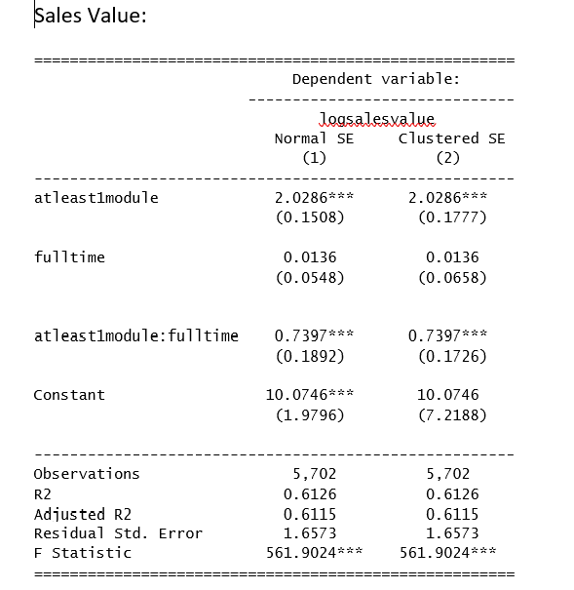
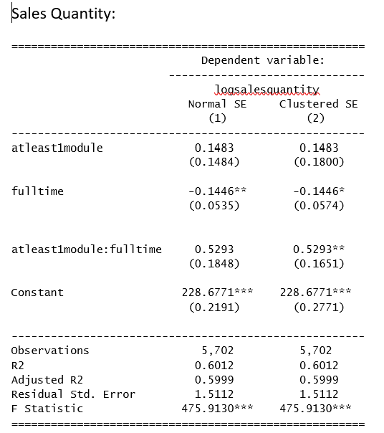
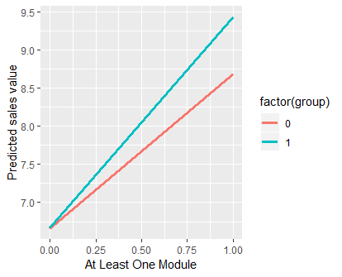
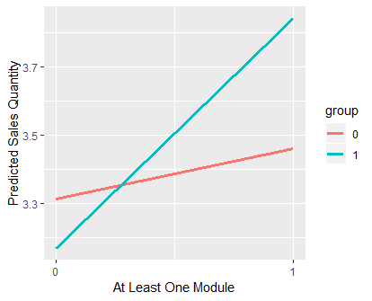
Interpretation of Results
SALES VALUE
SALES QUANTITY

Slide 16
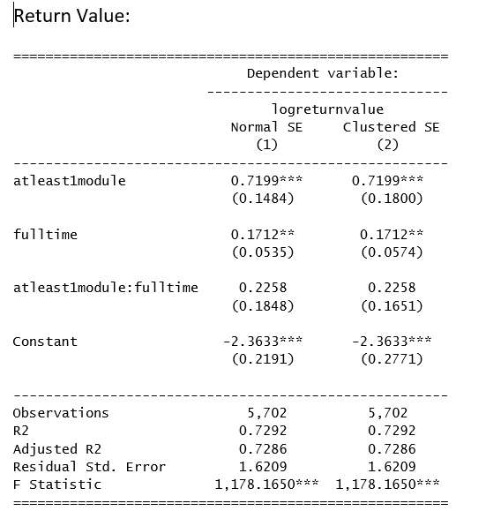
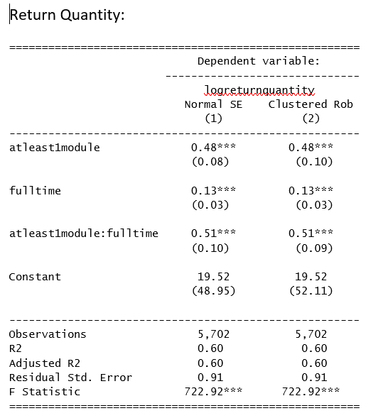
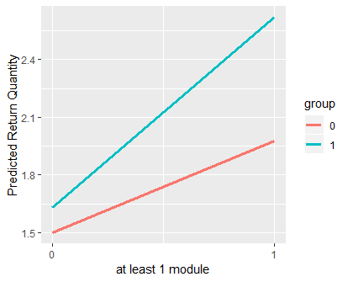
Interpretation of Results
RETURN VALUE
RETURN QUANTITY
Interaction insignificant, there’s no impact of being fulltime and taking at least one training on salesperson’s return value.

Slide 17
Our Approach to Data Analysis…
5
Who benefits from the training more : more experienced employees or less experienced employees?
SALES VALUE
SALES QUANTITY
RETURN VALUE
RETURN QUANTITY
Data Segregation
(2012, 2013)
Data Segregation
(2012, 2013)
Data Segregation
(2012, 2013)
Data Segregation
(2012, 2013)
OLS Model
(atleast1module*serviceyears)
Poisson / NB Model
(atleast1module*serviceyears)
OLS Model
(atleast1module*serviceyears)
Poisson / NB Model
(atleast1module*serviceyears)
Compare
Compare
IV / 2SLS Model
(married, child)
Negative Binomial Model
IV / 2SLS Model
(married, child, trainedratio)
Negative Binomial Model
Doesn’t Pass
Compare with OLS
Doesn’t Pass
Compare with OLS
OLS Model
OLS Model
OLS Model
OLS Model
Plot Graphs
IV / 2SLS Model
(married, child, trainedratio)
Plot Graphs
IV / 2SLS Model
(married, child, trainedratio)
Doesn’t Pass
Doesn’t Pass
Plot Graphs using OLS
Plot Graphs using OLS

Slide 18
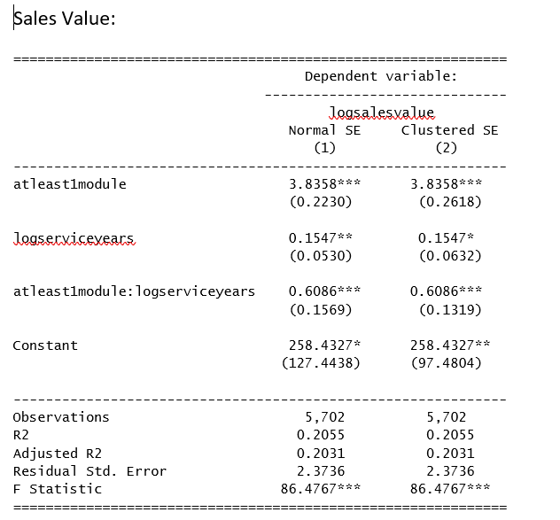
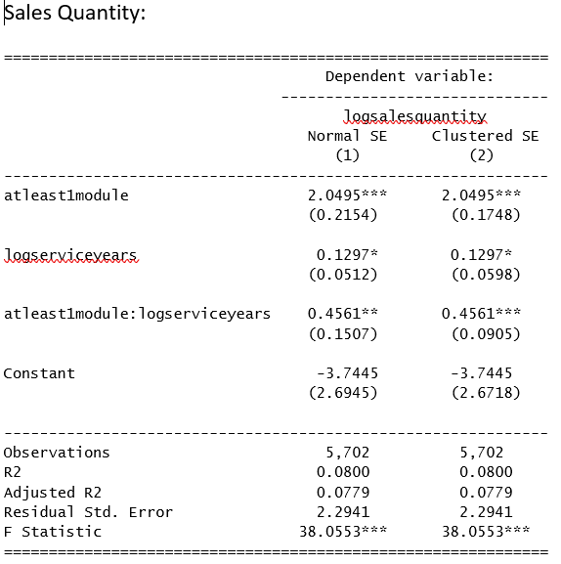
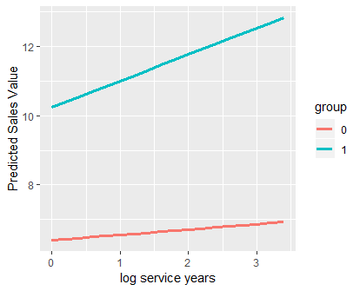
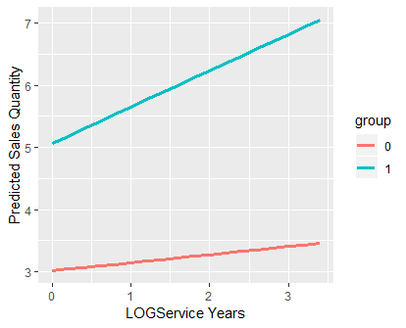
Interpretation of Results
SALES VALUE
SALES QUANTITY

Slide 19
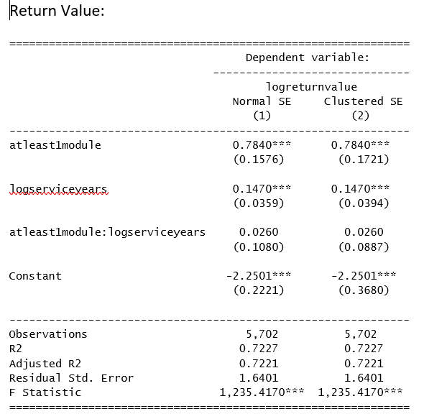
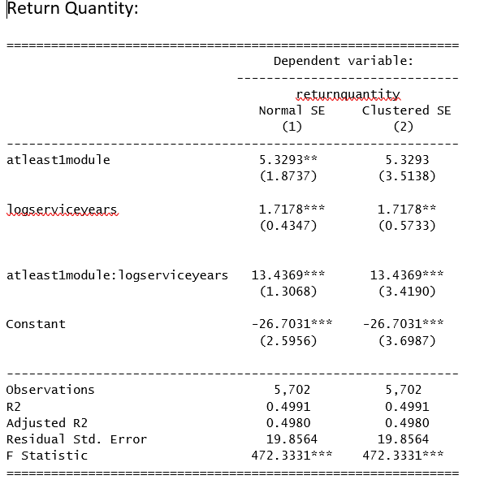
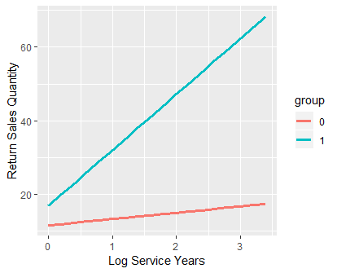
Interpretation of Results
RETURN VALUE
RETURN QUANTITY
The interaction term is insignificant.

Slide 20
Our Approach to Data Analysis…
6
Is the impact of training on sales performance different for employees who completed the service and selling training from that for employees who did not complete the service and selling training ?
SALES VALUE
SALES QUANTITY
Data Segregation
(2012, 2013)
Data Segregation
(2012, 2013)
OLS Model
(serviceselling*pknowledge)
Poisson / NB Model
(serviceselling*pknowledge)
Compare
IV / 2SLS Model
(married, child, trainedratio)
Poisson Model
Pass
Compare with OLS
Plot Graphs
OLS Model
IV / 2SLS Model
(married, child, trainedratio)
Doesn’t Pass
Plot Graphs using OLS

Slide 21
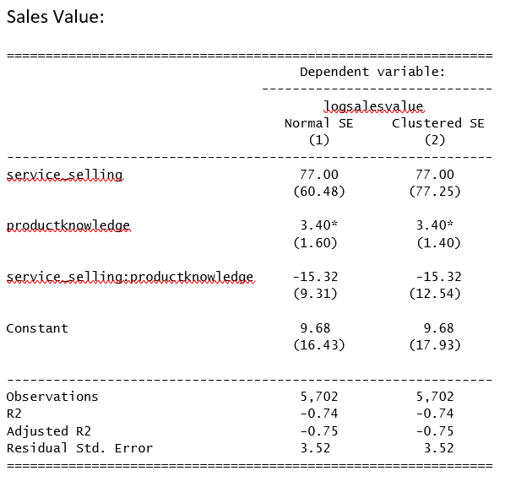
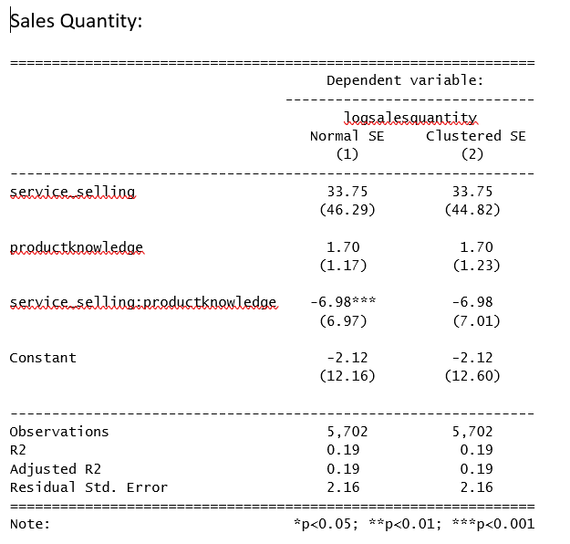
Interpretation of Results
SALES VALUE
SALES QUANTITY
The interaction term is insignificant. Thus the conclusion is the impact of training on sales value is the same for employees who took service and selling training and those who didn’t complete the service and selling training
The interaction term is insignificant. Thus the conclusion is the impact of training on sales quantity is the same for employees who took service and selling training and those who didn’t complete the service and selling training

Slide 22
Limitations
Missing data in the dataset impacts analysis
Lack of Instrumental Variables results in biased coefficients/incomplete analysis
Insufficient store level information couldn’t explain the change in sales and return behavior with respect to changes in salesperson’s behavior
Unavailability of the price range of the products results in inadequate comparison for sales quantity and value changes
Lack of information on product categories being sold could not explain the variation in sales corresponding to the training module being taken
Some insights on the background including experience years, education of the salesperson would have captured the impact of training

Slide 23
Managerial Insights / Conclusions
The impact can be summarized as follows
No significant impact of overall training program on sales, however, the returns increases which signifies over-selling
Increase in training modules increases the sales only for initial modules. Any additional module after that decreases the sales
Full- time employees benefit more as compared to the part time employees. This can be attributed to the salaries, motivation level for the two groups
The sales increases with increase in service years
No significant impact of service and selling.
Capturing more data pertaining to existing variables for an extended period
Identifying and capturing new parameters that includes salesperson’s background information(experience years, education), store level information including promotions specific to the stores
Customized training modules and restriction/penalty on return for salespeople can be tested as a control to decrease the returns

Slide 24
Thankyou !
Notes:
You can use this slide as your opening or closing slide. Should you choose to use it as a closing, make sure you review the main points of your presentation. One creative way to do that is by adding animations to the various graphics on a slide. This slide has 4 different graphics, and, when you view the slideshow, you will see that you can click to reveal the next graphic. Similarly, as you review the main topics in your presentation, you may want each point to show up when you are addressing that topic.
Add animation to images and graphics:
Select your image or graphic.
Click on the Animations tab.
Choose from the options. The animation for this slide is “Split”. The drop-down menu in the Animation section gives even more animations you can use.
If you have multiple graphics or images, you will see a number appear next to it that notes the order of the animations.
Note: You will want to choose the animations carefully. You do not want to make your audience dizzy from your presentation.

